Slide 1
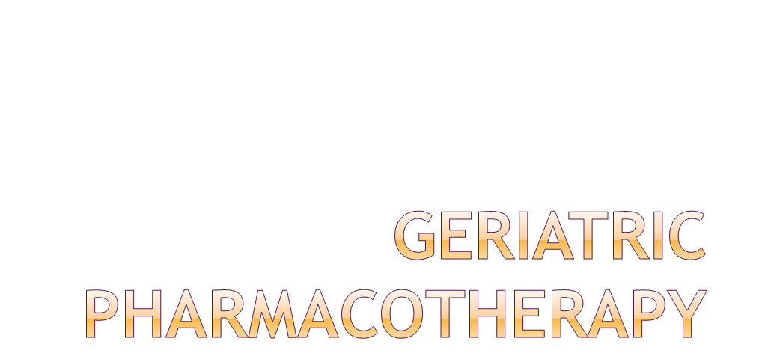
Dr. Priti Patel

Slide 2

Understand key issues in geriatric pharmacotherapy
Understand the effect age on pharmacokinetics and pharmacodynamics
Discuss risk factors for adverse drug events and ways to mitigate them
Understand the principles of drug prescribing for older patients

Slide 3

New drugs available each year
FDA approved and off-label indications are expanding
Changing managed-care formularies
Advanced understanding of drug-drug interactions
Increasing popularity of “nutriceuticals”
Multiple co-morbid states
Polypharmacy
Medication compliance
Effects of aging physiology on drug therapy
Medication cost

Slide 4

Absorption
  bioavailability: the fraction of a drug dose reaching the systemic circulation
Distribution
  locations in the body a drug penetrates expressed as volume per weight (e.g. L/kg)
Metabolism
  drug conversion to alternate compounds which may be pharmacologically active or inactive
Elimination
  a drug’s final route(s) of exit from the body expressed in terms of half-life or clearance

Slide 5

  decreased lean body mass
    affects drug distribution
  decreased levels of serum albumin
    affects drug distribution
  decreased liver function
    affects drug metabolism/biotransformation
  decreased renal function
    affects drug elimination

Slide 6

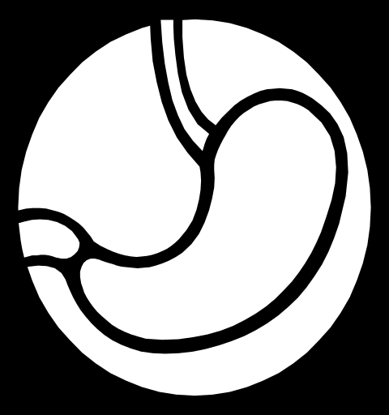
Rate of absorption may be delayed
  Lower peak concentration
  Delayed time to peak concentration
Overall amount absorbed (bioavailability) is unchanged

Slide 7

gastrointestinal system (rarely significant clinically)
acid production generally unchanged
multiple prescriptions increase the probability of drug-drug interaction which may alter absorption
splanchnic blood flow decreases (with little effect on drug absorption)

Slide 8

Increased GI pH
  Calcium carbonate, “azoles”, iron
Slower gastric motility/emptying
Increased fat/decreased muscle
  Transdermal, IM, SQ
Dysphagia may potentially alter absorption
Overall, extent or rate of absorption not significantly altered
Notes:
Look at PSAP page 129
Drug drug and drug food interactions are more likely to alter absorption

Slide 9

For drugs with extensive first-pass metabolism, bioavailability may increase because less drug is extracted by the liver
  Decreased liver mass
  Decreased liver blood flow

Slide 10

Route of administration
What it taken with the drug
  Divalent cations (Ca, Mg, Fe)
  Food, enteral feedings
  Drugs that influence gastric pH
  Drugs that promote or delay GI motility
Comorbid conditions
Increased GI pH
Decreased gastric emptying
Dysphagia

Slide 11

fluid and tissue compartments
  decrease in total body water
  increase in fat compartment
  decrease in muscle mass
plasma drug-binding proteins (rarely significant clinically)
  decrease in serum albumin levels
  no change in α-acid glycoprotein levels

Slide 12

Aging Effect | Vd Effect | Examples
⇓ body water | ⇓ Vd for hydrophilic drugs | ethanol, lithium
⇓ lean body mass | ⇓ Vd for for drugs that bind to muscle | digoxin
⇑ fat stores | ⇑ Vd for lipophilic drugs | diazepam, trazodone
⇓ plasma protein (albumin) | ⇑ % of unbound or free drug (active) | diazepam, valproic acid, phenytoin, warfarin
⇑ plasma protein (α₁-acid glycoprotein) | ⇓ % of unbound or free drug (active) | quinidine, propranolol, erythromycin, amitriptyline

Slide 13
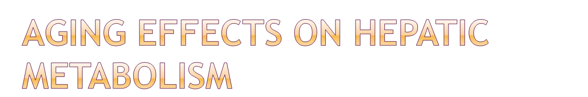
Metabolic clearance of drugs by the liver may be reduced due to:
  decreased hepatic blood flow
  decreased liver size and mass
Examples: morphine, meperidine, metoprolol, propranolol, verapamil, amitryptyline, nortriptyline

Slide 14

Pathway | Effect | Examples
Phase I: oxidation, hydroxylation, dealkylation, reduction | Conversion to metabolites of lesser, equal, or greater | diazepam, quinidine, piroxicam, theophylline
Phase II: glucuronidation, conjugation, or acetylation | Conversion to inactive metabolites | lorazepam, oxazepam, temazepam
** NOTE: Medications undergoing Phase II hepatic metabolism are generally preferred in the elderly due to inactive metabolites (no accumulation)

Slide 15
An 82 year old white woman has been having anxiety due to the anniversary of her husband’s death. Which one of the following would be the safest pharmacologic treatment for her anxiety?
Alprazolam
Chlordiazepoxide
Diazepam
Lorazepam

Slide 16
An 82 year old white woman has been having anxiety due to the anniversary of her husband’s death. Which one of the following would be the safest pharmacologic treatment for her anxiety?
Alprazolam
Chlordiazepoxide
Diazepam
Lorazepam

Slide 17
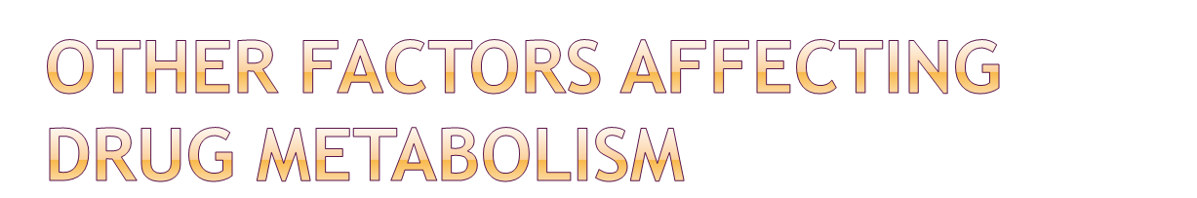
Gender
Comorbid conditions
Smoking
Diet
Drug interactions
Race
Frailty

Slide 18

Meperidine (normeperidine)
Morphine (M3G and M6G)
Propoxyphene (norpropoxyphene)
Venlafaxine (O-desmethylvenlafaxine)
Carbamazepine (Carbamazepine-10,11-epoxide)
Notes:
Normeperidine lowers the seizure threshold
M3G - CNS stimulation (myoclonus, delirium, seizures)
M6G - additive opiate effect
Norpropoxyphene - lowers seizure threshold

Slide 19

Half-life
  time for serum concentration of drug to decline by 50% (expressed in hours)
Clearance
  volume of serum from which the drug is removed per unit of time (mL/min or L/hr)
Reduced elimination ⇒ drug accumulation and toxicity

Slide 20

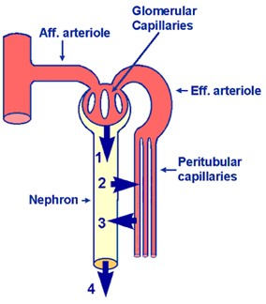
decrease in renal functions
  decreased blood flow to the kidneys
  decreased glomerular filtration
  decreased tubular secretion
  decline in creatinine clearance

Slide 21

Decreased kidney size
Decreased renal blood flow
Decreased number of functional nephrons
Decreased tubular secretion
Result: ⇓ glomerular filtration rate (GFR)
Decreased drug clearance: atenolol, gabapentin, H2 blockers, digoxin, allopurinol, quinolones

Slide 22

Creatinine clearance (CrCl) is used to estimate glomerular rate
Serum creatinine alone not accurate in the elderly
  ⇓ lean body mass ⇒ lower creatinine production
  ⇓ glomerular filtration rate
Serum creatinine stays in normal range, masking change in creatinine clearance

Slide 23

Measure
  Time consuming
  Requires 24 hr urine collection
Estimate
  Cockroft Gault equation
  (IBW in kg) x (140-age)
  ------------------------------ x (0.85 for females)
  72 x (Scr in mg/dL)

Slide 24

Age
Scr
CrCl
30
1.1
65
50
1.1
53
70
1.1
41
90
1.1
30

Slide 25

target organ changes
  decreased desirable effects of pharmacotherapy
  increased adverse effects
homeostasis changes
  decreased capacity to respond to physiological challenges and the adverse side effects of drug therapy (eg., orthostatic hypotension)

Slide 26

Some effects are increased
  alcohol increases drowsiness and lateral sway
  e.g. diazepam, morphine, theophylline
Some effects are decreased
  diminished HR response to β-blockers
Notes:
Page 82 dipiro
Less predictable and often altered drug response at usual or lower concentrations
Drug-drug and drug disease interactions may alter response
Prolonged pain relief with opioids at lower doses; increased sedation and postural instability to benzodiazepines, altered sensitivity to beta blockers
In some patients, particularly those that are frail, the use of lower doses, longer intervals between doses, and longer periods between changes in dose are ways to successfully manage drug therapy and decrease the chances of medication intolerance or toxicity. Disease and drug specific monitoring are also necessary to ensure a successful outcome.

Slide 27

Definition: the time course and intensity of pharmacologic effect of a drug
Age-related changes:
  ⇑ sensitivity to sedation and psychomotor impairment with benzodiazepines
  ⇑ level and duration of pain relief with narcotic agents
  ⇑ drowsiness with alcohol
  ⇓ HR response to beta-blockers
  ⇑ sensitivity to anti-cholinergic agents
  ⇑ cardiac sensitivity to digoxin

Slide 28

PK and PD changes generally result in decreased clearance and increased sensitivity to medications in older adults
Use of lower doses, longer intervals, slower titration are helpful in decreasing the risk of drug intolerance and toxicity
Careful monitoring is necessary to ensure successful outcomes

Slide 29
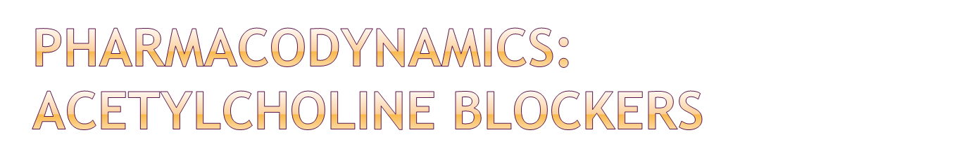
Decreased tolerance to adverse effects
Constipation, urinary retention
Dry mouth, dry eyes, dry skin
Memory impairment
Delirium

Slide 30

Pattern of toxicity – young vs. elderly
Increased cardiac sensitivity to digoxin due to:
  Hypokalemia, hypothyroidism, hypomagnesemia, hypercalcemia, acute hypoxia

Slide 31
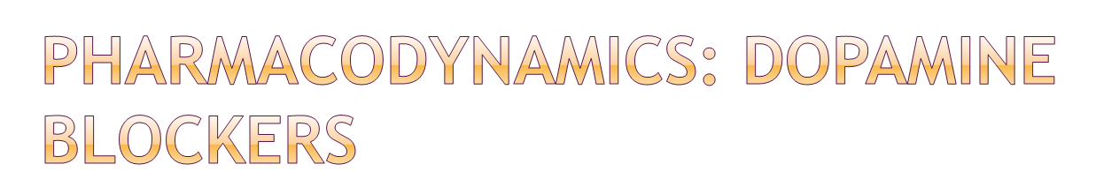
CNS dopamine decline
Adverse drug effects from antipsychotic agents, metoclopramide
  Extrapyramidal effects
  Parkinsonism
  Tardive dyskinesia

Slide 32

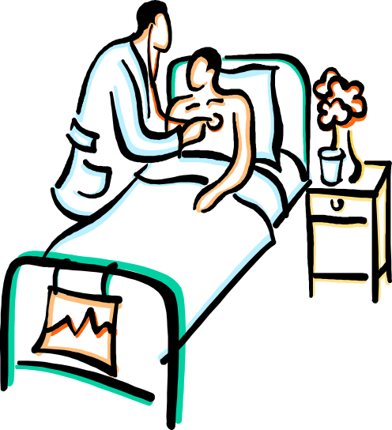
Responsible for 5-28% of acute geriatric hospital admissions
Greater than 95% of ADEs in the elderly are considered predictable and approximately 50% are considered preventable
Most errors occur at the ordering and monitoring stages

Slide 33

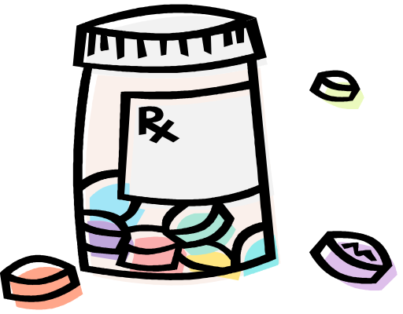
Opioid analgesics
NSAIDs
Anticholinergics
Benzodiazepines
Also: cardiovascular agents, CNS agents, and musculoskeletal agents
Adverse Drug Reaction Risk Factors in Older Outpatients. Am J Ger Pharmacotherapy 2003;1(2):82-89.

Slide 34

Drug 1
ADE interpreted as new medical condition
Drug 2
ADE interpreted as new medical condition
Drug 3
Rochon PA, Gurwitz JH. Optimizing drug treatment in elderly people: the prescribing cascase. BMJ 1997;315:1097.

Slide 35

Initial treatment | Adverse effect | Subsequent treatment | Subsequent adverse effect
NSAIDs | Rise in blood pressure | Antihypertensive treatment | Orthostatic hypotension
Thiazide diuretics | Hyperuricaemia | Allopurinol | Hypersensitivity reaction (Skin rashes)
Metoclopramide treatment | Parkinsonian symptoms | Treatment with levodopa | Visual and auditory hallucination
(Source: Adapted from Rochon and Gurwitz, 1997)

Slide 36
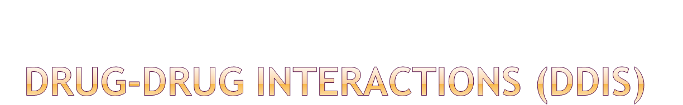
May lead to adverse drug events
Likelihood ⇑ as number of medications ⇑
Most common DDIs:
  cardiovascular drugs
  psychotropic drugs
Most common drug interaction effects:
  confusion
  cognitive impairment
  hypotension
  acute renal failure

Slide 37

Combination | Risk
ACE inhibitor + potassium | Hyperkalemia
ACE inhibitor + K sparing diuretic | Hyperkalemia, hypotension
Digoxin + antiarrhythmic | Bradycardia, arrhythmia
Digoxin + diuretic Antiarrhythmic + diuretic | Electrolyte imbalance; arrhythmia
Diuretic + diuretic | Electrolyte imbalance; dehydration
Benzodiazepine + antidepressant Benzodiazepine + antipsychotic | Sedation; confusion; falls
CCB/nitrate/vasodilator/diuretic | Hypotension
Doucet J, Chassagne P, Trivalle C, et al. Drug-drug interactions related to hospital admissions in older adults: a prospective study of 1000 patients. J Am Geriatr Soc 1996;44(9):944-948.

Slide 38

Obesity alters Vd of lipophilic drugs
Ascites alters Vd of hydrophilic drugs
Dementia may ⇑ sensitivity, induce paradoxical reactions to drugs with CNS or anticholinergic activity
Renal or hepatic impairment may impair metabolism and excretions of drugs
Drugs may exacerbate a medical condition

Slide 39

Combination | Risk
NSAIDs + CHF Thiazolidinediones + CHF | Fluid retention; CHF exacerbation
BPH + anticholinergics | Urinary retention
CCB + constipation Narcotics + constipation Anticholinergics + constipation | Exacerbation of constipation
Metformin + CHF | Hypoxia; increased risk of lactic acidosis
NSAIDs + gastropathy | Increased ulcer and bleeding risk
NSAIDs + HTN | Fluid retention; decreased effectiveness of diuretics

Slide 40

Avoid prescribing prior to diagnosis
Start with a low dose and titrate slowly
Avoid starting 2 agents at the same time
Reach therapeutic dose before switching or adding agents
Consider non-pharmacologic agents

Slide 41

Determine therapeutic endpoints and plan for assessment
Consider risk vs. benefit
Avoid prescribing to treat side effect of another drug
Use 1 medication to treat 2 conditions
Consider drug-drug and drug-disease interactions
Use simplest regimen possible
Adjust doses for renal and hepatic impairment
Avoid therapeutic duplication
Use least expensive alternative

Slide 42

Balance between overprescribing and underprescribing
  Correct drug
  Correct dose
  Targets appropriate condition
  Is appropriate for the patient
  Avoid “a pill for every ill”
  Always consider non-pharmacologic therapy

Slide 43

Suboptimal prescribing
Medication Errors
Medication nonadherence
Notes:
Suboptimal prescribing includes overuse of medications or polypharmacy, inappropriate use, and uderuse
Errors include both dispensing and administration problems
Nonadherence related to intentional and unintentional.

Slide 44
Is there an indication?
Is the medication effective for the condition?
Is the dosage correct?
Are the directions correct?
Are the directions practical?
Are there clinically significant drug-drug interactions?
Are there clinically significant drug-disease interactions?
Is there unnecessary duplication?
Is the duration of therapy acceptable?
Is this drug the least expensive alternative?
Notes:
If do not use this index can use explicit criteria found in “Beers” list – updated 2003
Several other factors should be assessed including
Suboptimal medication choice, based on effectiveness, safety, cost and effects on health related qol
Allergy
Undertreatment
Drug interactions with food or laboratory tests

Slide 45

Compatible safety and side effect profile
Low risk of drug/nutrient interactions
T_{1/2} < 24h with no active metabolites
No adjustments for renal/hepatic function
Strength/dosage form match recommendations for older adults
Notes:
Established efficacy – use newly approved drugs cautiously as they are likely to be more expensive and information about their use in older adults is often limited

Slide 46

What is unique about the new drug?
Is clinical data available?
How does it compare with traditional therapy?
Cost?
Coverage by third party payers?
Does potential advantage justify risk of new drug?

Slide 47
Obtain complete drug history
Avoid prescribing prior to diagnosis
Review medications regularly
Know actions, adverse effects, toxicity
Start at low dose and titrate
Try not to start two drugs at the same time
Reach therapeutic dose before switching/adding
Consider non-pharmacological alternatives
Notes:
Complete history including herbs, otc – have patients bring in medications to each visit
Discontinue drugs when possible if benefit unclear or side effects could be due to drug
Be cautious with newer drugs.
Consider if the benefit of the 7th or 8th drug is sufficient to justify the cost, increase in complexity of regimen and risk of side effects.
Start low, go slow, but get there
Avoid medications if benefit is marginal or if non-pharmacological alternatives exist

Slide 48

Educate patient/caregiver
Use one drug to treat two conditions
Keep regimen as simple as possible
Caution with combination products
Communicate with other prescribers
Avoid drugs from same class/similar actions
Avoid one drug to treat side effect of another
Notes:
Write instructions out clearly for the patient/family

Slide 49
Adverse drug events (ADEs)
Drug interactions
Duplication of drug therapy
Decreased quality of life
Unnecessary cost
Medication non-adherence

Slide 50


Review medications regularly and each time a new medication started or dose is changed
Maintain accurate medication records (include vitamins, OTCs, and herbals)

Slide 51


Rate may be as high as 50% in the elderly
Factors in non-adherence
  Financial, cognitive, or functional status
  Beliefs and understanding about disease and medications

Slide 52

Avoid newer, more expensive medications that are not shown to be superior to less expensive generic alternatives
Simplify the regimen
Utilize pill organizers or drug calendars
Educate patient on medication purpose, benefits, safety, and potential ADEs

Slide 53

Successful pharmacotherapy means using the correct drug at the correct dose for the correct indication in an individual patient
Age alters PK and PD
ADEs are common among the elderly
Risk of ADEs can be minimized by appropriate prescribing

Slide 54



